Slide 1

TypeScript
By Ben Tweet & Sandra Opakunle

Slide 2
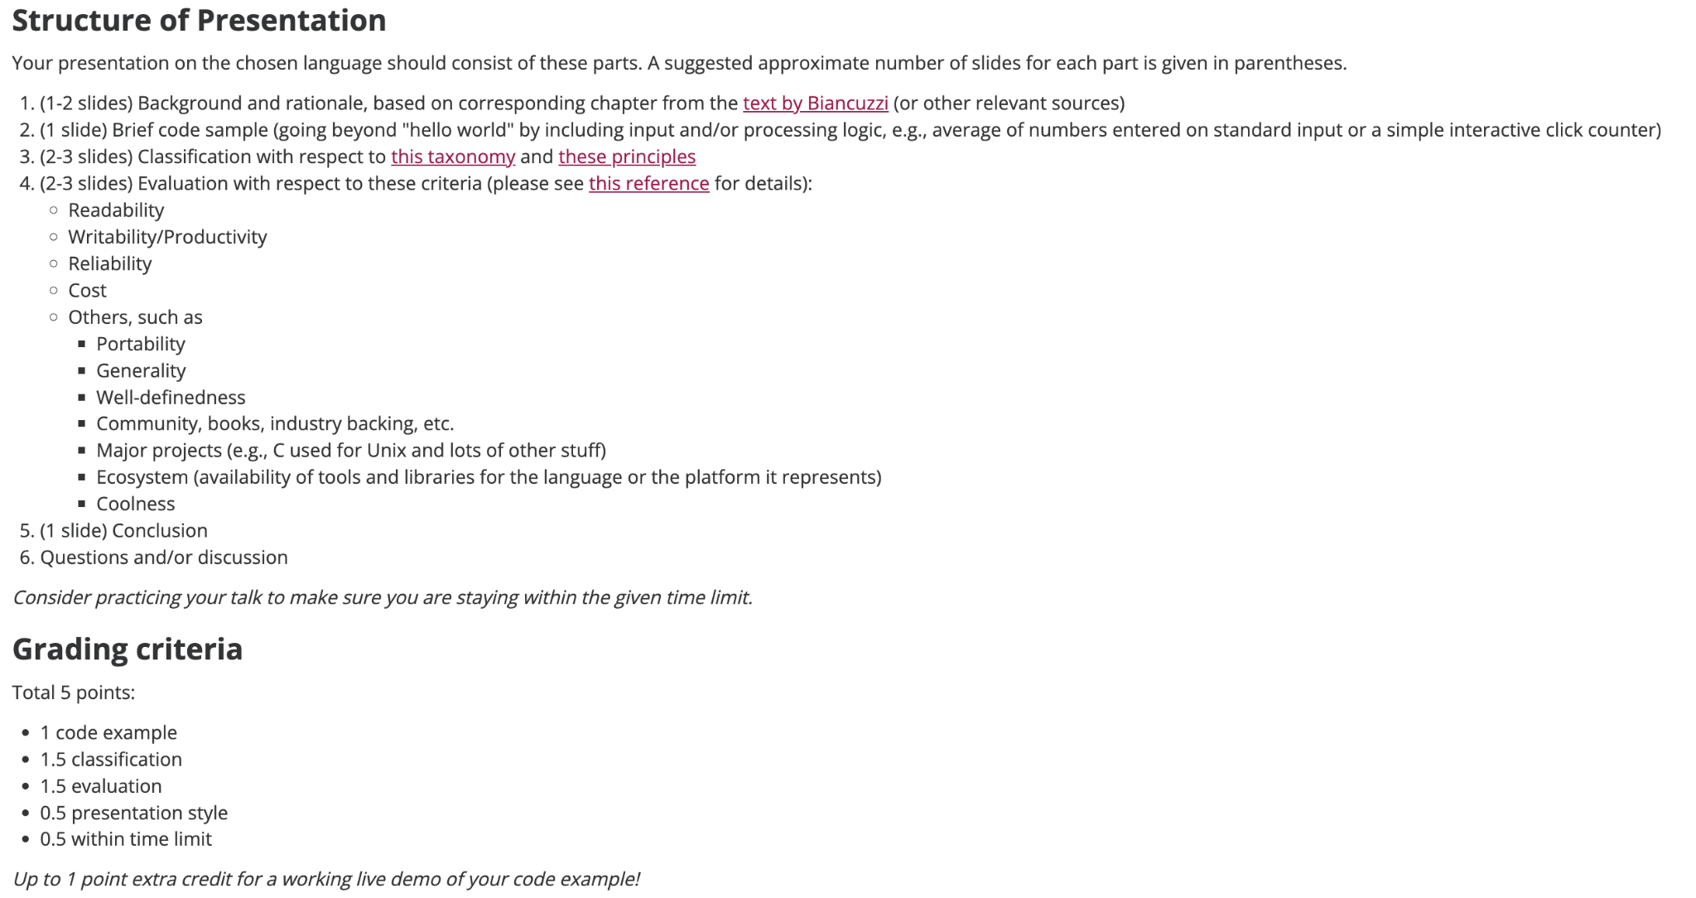

Slide 3
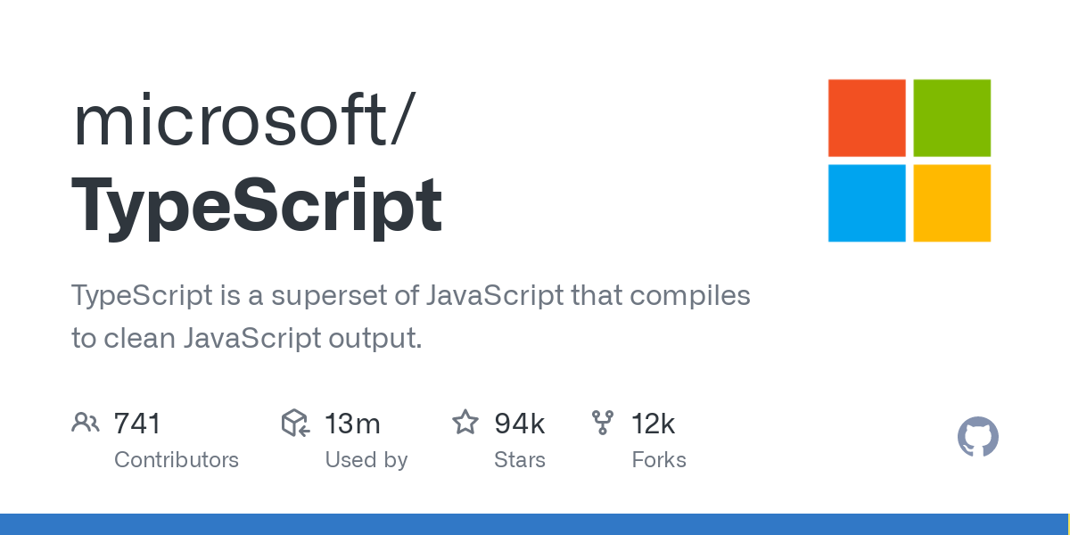
History of TypeScript
Programming language created in 2012 by Microsoft that supersets JavaScript.
Address shortcomings of JavaScript when building large scale applications
JS which is a dynamic typed language could not catch certain types of errors during development
TypeScript is a static type which allows developers to define and enforce types in their code. Allowing for early detection of errors to improve support.
Notes:
TypeScript is a Programming language created in 2012 by Microsoft which supersets JavaScript.
Created to address the shortcomings of JavaScript when it came to building large scale applications
JS which is a dynamic typed language could not catch certain types of errors during development which led to bugs and unexpected behavior for applications
TypeScript is a static type which allows developers to define and enforce types in their code. Allowing for early detection of errors to improve support

Slide 4
Background continue…
IDE (integrated development environment) support and code navigation to JS providing accurate auto completion and code refactoring
New features to JS such as classes, interfaces, modules, and decorators.. Enhanced organization, maintainability, and reusability.
Goal was not to replace JS but to enhance it and provide better tooling. Scalability, and error detection on large scale projects.
Notes:
Bring better IDE support and code navigation to JS which provide accurate auto completion suggestions and code refactoring to making developers more productive.
It also introduced new feature to JS such as classes, interfaces, modules, and decorators which are not standard to JS.. Enhances organization, maintainability, and reusability.
Goal was not to replace JS but to enhance it and provide better tooling. Scalability, and error detection on large scale projects. It compiles down to JS to be executed.

Slide 5
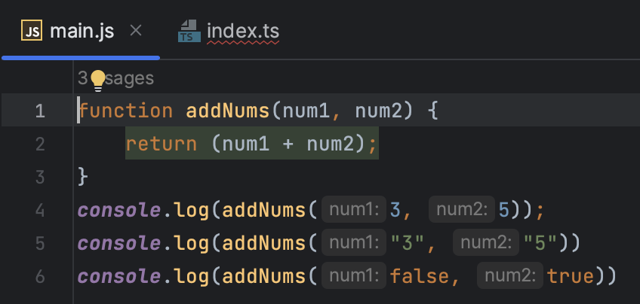
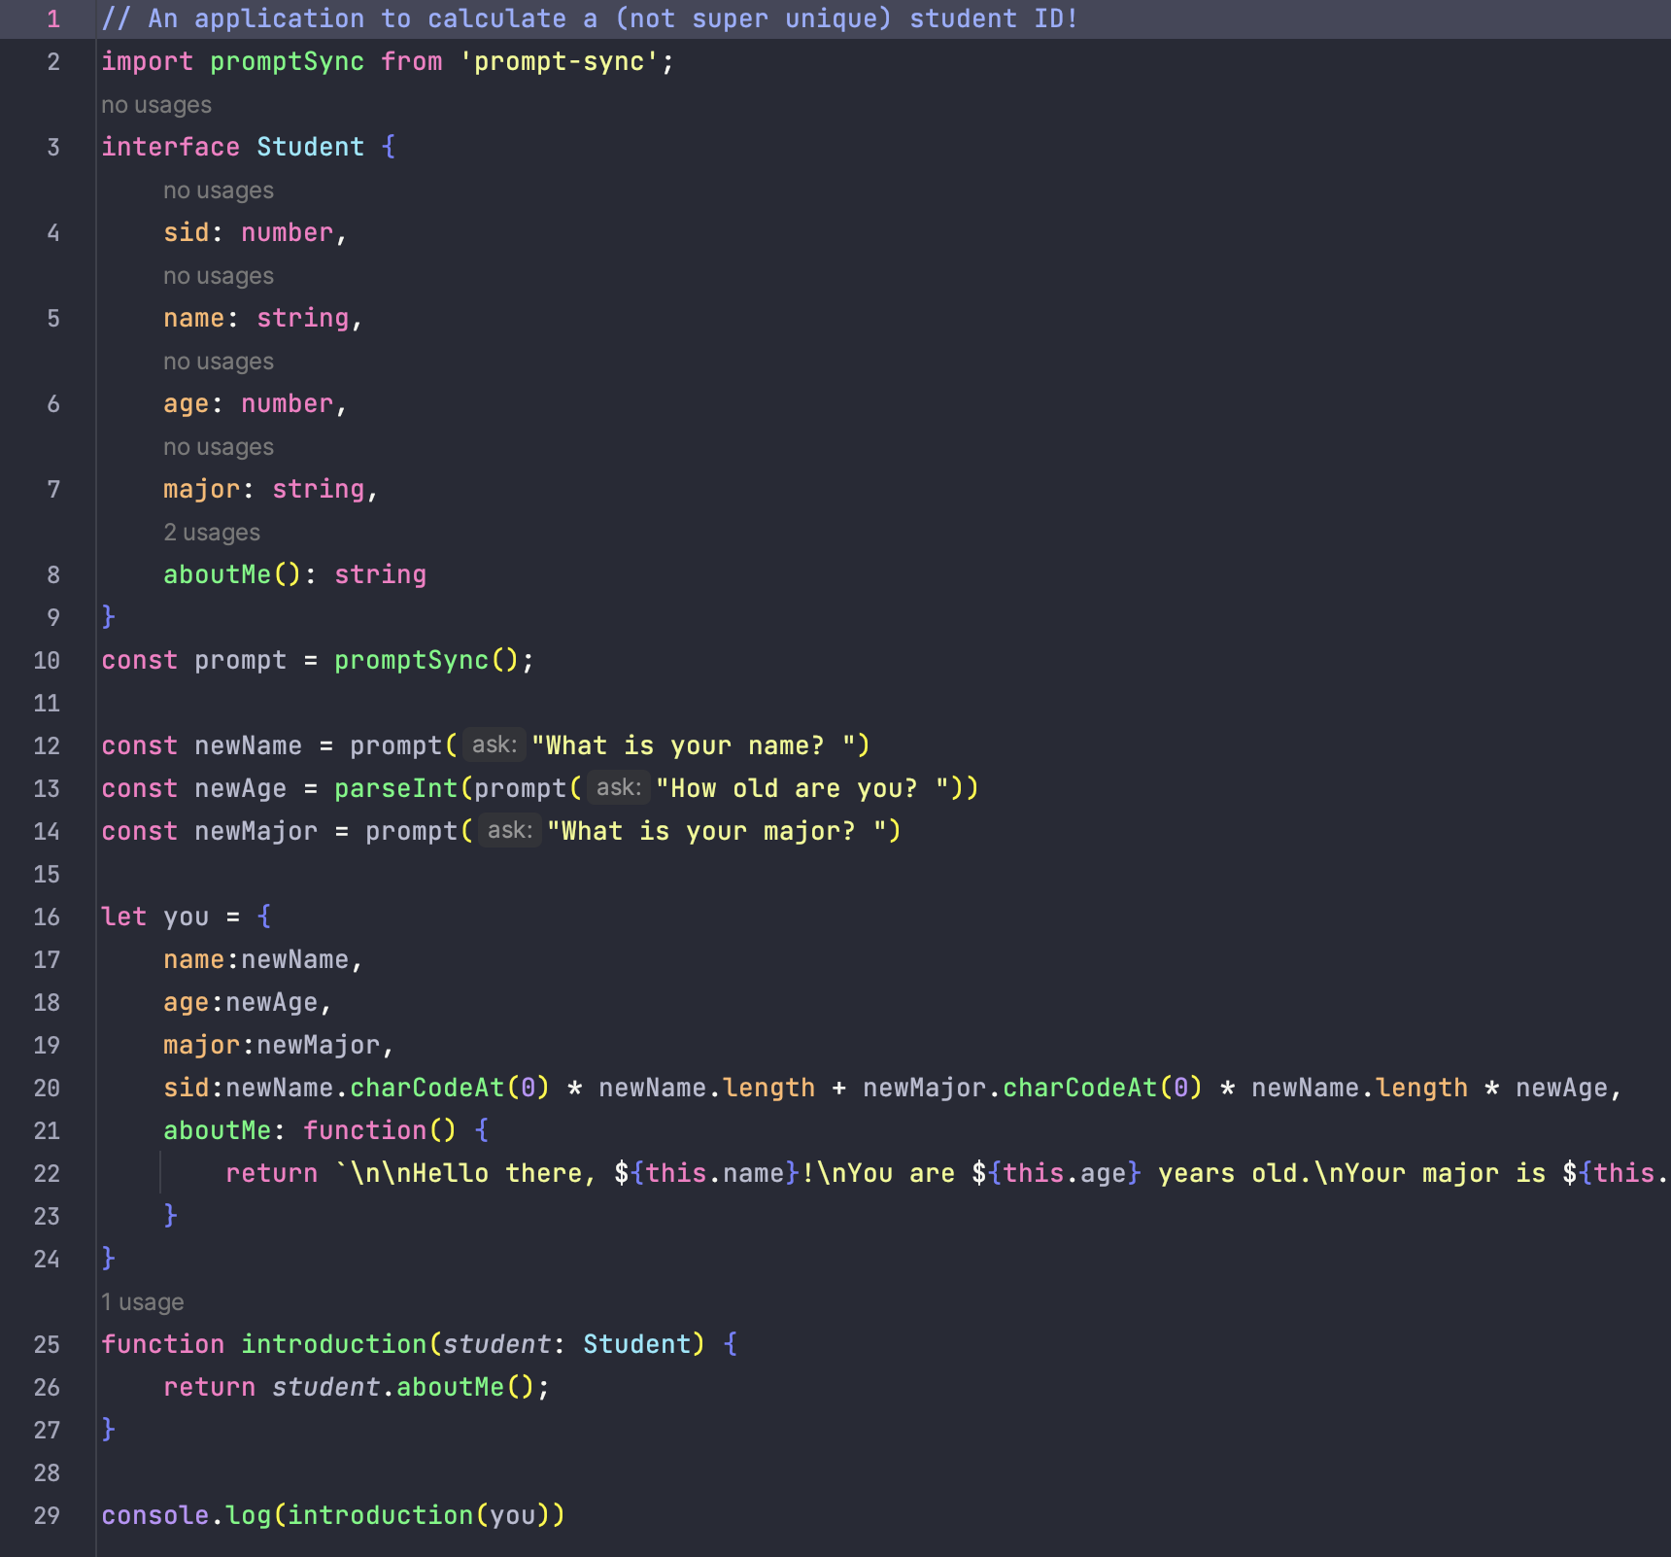
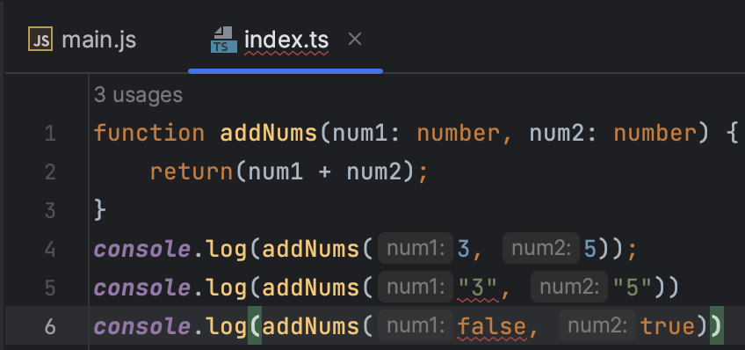
Code Sample
Basic Introduction to Typescript Type Checking
More Complex Example
JS
TS

Slide 6
Design Principles in TypeScript
Abstraction - TypeScript allows for abstraction through the ability to make abstract classes/interfaces to hide low-level details and provide users with just necessary information
Automation - The build-in type checking behavior of TypeScript allows for automation in testing, with real-time type errors to the user.
Portability - TypeScript is portable, in that it can be ran on any system that supports JavaScript
Security - TypeScript, because of its very strong typing/highly customizable type definitions, the language allows for increased application security
Notes:
Typescript allows for abstraction in that it provides the opportunity, similar to Java, for use of abstract classes and interfaces to help factor out recurring patterns. In using these, one can effectively hide unnecessary, repetitive, low level information from the users, and only give them the details about the application most useful to them.
Because of the highly-typed nature of TypeScript, and its built-in type checking functionality, when a user attempts to, for example, pass an argument of an unexpected or incompatible type into a method, they are provided error messages directly in the IDE in real-time, an excellent tool for helping users prevent small errors before they even become a problem.
Because TypeScript simply compiles to JavaScript, it can be ran on any system that also supports JavaScript, as it does not require its own VM (like Java, for instance) or specific runtime environment
As a result of TypeScripts very strongly typed nature, and the ability of one to create highly specified custom types within it, the user is able to ensure that methods/variables are only using the very specific data that they were made for, drastically lowering the potential for type-related errors or attacks that might be present in a language like JavaScript for instance.
Just like JavaScript

Slide 7
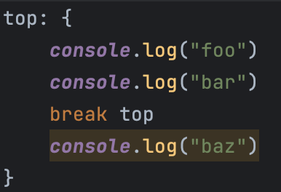
Design Principles in TypeScript
Labeling - Because JavaScript allows for labeling, this behavior is also present in TypeScript
Principles NOT clearly present in TypeScript:
Regularity - Because of “exceptions” to typing, ie. the “any” type, might not be considered regular
Simplicity (could go both ways) - While the language does pose a “simpler” alternative to JavaScript given certain use cases (need for type checking), the syntax can be trickier
Notes:
There is the option for labeling where statements/code blocks may be preceded by a label that can then be used, in this example, to refer to a block and break out of a code block under that one label. This functionality remains consistent in TypeScript, as it maintains much of the same functionality as JavaScript.
Additionally, we wanted to outline some principles that were not so much present in TypeScript, at least in our initial researching of the language.
To start, regularity is something that might not be TypeScript’s strong suit. An example of this is the “any” type, that can effectively act as an “exception” to any type and cause problems when used carefully (or used at all, this is basically the same thing as just using regular JavaScript, where parameters are not checked for type). An object or variable of type “any” can be used to substitute for any variable of a more specific type.
Simplicity is another principle that could be argued both ways in regards to TypeScript, however we thought it fell on the not present side. While this language does have a very readable, often concise syntax, certain small changes between more well known languages, the foremost of which, of course, being JavaScript, could prove confusing to get the hang of

Slide 8
Evaluation
Readability
Enforcing strict typing making it easier to understand code and catch errors early
Addition of classes, interfaces, and modules which enhances code organization
Provides comprehensible error messages and aiding in debugging
Writability/Productivity
Enables developers to write cleaner and more maintainable code through features like static typing, type inference, and tooling support
Advanced IDE features such as autocompletion and navigation
Support for modern JS features and libraries
Notes:
TypeScript provides very elegant solutions for the addition of type checking to JavaScript, and hides the convoluted JavaScript that is necessary to run an application with the desired functionality (which is written in TypeScript) in a specified output folder from which the app will be actually ran. However, for new eyes reading code, or even developers actively building a TypeScript application, the developer-facing code is very easy to write and reminiscent of JavaScript and Java, so is a very easy lateral move for programmers familiar with either language
As mentioned before, TypeScript streamlines many processes that would otherwise get tedious and verbose in JavaScript. As such, developers save time coding while simultaneously producing a powerful product that is even more secure/robust than a vanilla JavaScript application might have been.
Additionally, the tsconfig file that was demoed earlier provides the user with an array of various deployment/build options that they can easily toggle/configure to further customize and optimize their app. For instance, one option allows the user to enable error reporting in the unique case where the “this” keyword is used in reference to an object of type “any” → This can be very helpful to prevent type checking errors or holes in a program’s security.

Slide 9
Evaluation continued…
Reliability
Catching errors during compilation, reducing runtime issues
Static typing helps identify potential bugs early in development process
Enforces constraints for reliabilable codebase
Cost
Reduces cost by catching and fixing errors during development so reduce debugging time
Productivity gained to improve maintainability of TypeScript can lead to saving in the long run
Notes:
TypeScript is portable, as it compiles down to JavaScript and can be executed in any modern JavaScript runtime.
It has a broad community and industry backing, with widespread adoption in large-scale projects.
Has a rich ecosystem with a wide range of tools, libraries, and frameworks.

Slide 10
Evaluation continued…
Others …
TypeScript is portable, as it compiles down to JavaScript and can be executed in any modern JavaScript runtime.
It has a broad community and industry backing, with widespread adoption in large-scale projects.
Has a rich ecosystem with a wide range of tools, libraries, and frameworks.

Slide 11
Conclusion
Typescript provides developers a means of writing elegant code that is reliable and easy to read
Its heavy typed nature and built-in type checking makes debugging a breeze
An excellent option for instances where security is a priority, and developers want to ensure they have type safety as a priority from day one
Requires very little new language learning if you have any exposure to JavaScript or Java, an easy move for many developers

Slide 12
Thank you
&
Questions?

